Slide 1
Awakening the Sleeping Giant of Latinx Philanthropy
April 16th, 2023
AFP ICON
New Orleans, Louisiana
Armando Enrique Zumaya
Founder
www.armandozumaya.com
www.somoselpoder.org

Slide 2
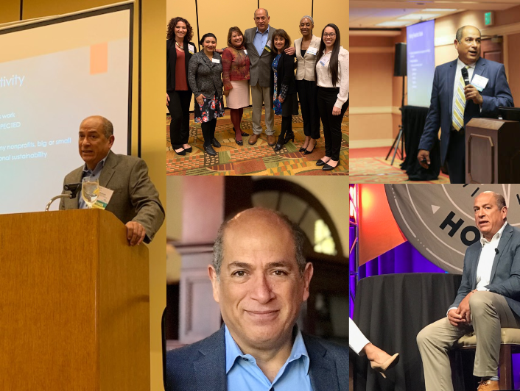
About Me
Born and raised in East LA
Grassroots vs Ivy League
36 years in fundraising and still mostly sane
Latino and boundary crosser
Prospecting Expert
Founded the first Latinx fundraising institute in the US-Somos El Poder
Master Creole Chef (Not kidding)

Slide 3

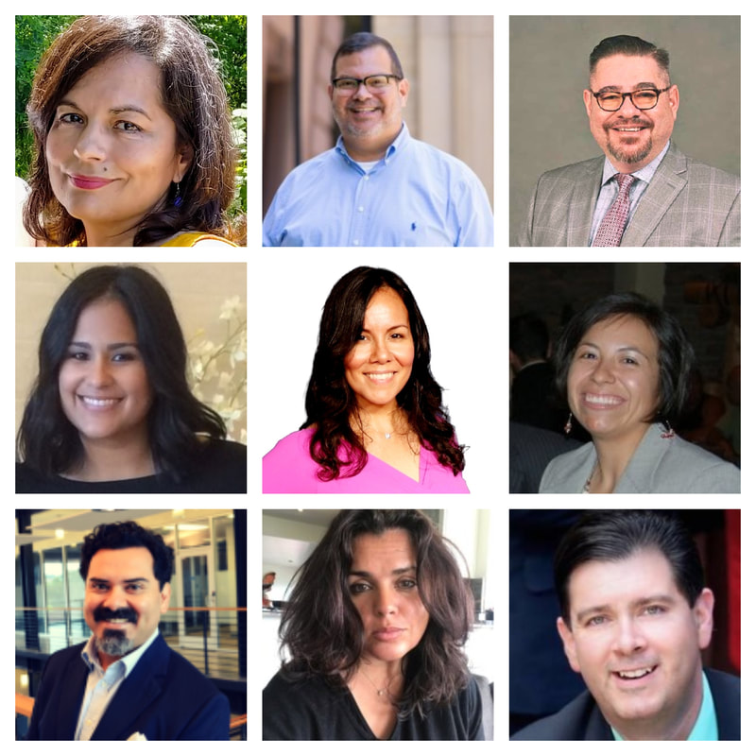


www.somoselpoder.org

Slide 4
Does your nonprofit serve the Latinx Community?

Slide 5
Latinx in the Nonprofit World
Ignored – Even in discussions of racism, bias and DEI.
Foundations give (pre pandemic) less that 1.8% of giving to Latinx focused nonprofits.
Less than 3% of Board Members are Latinx of nonprofits
Less than 7% of Foundation Staff are Latinx

Slide 6
The Sleeping Giant
Current giving focused on Catholic Church, remittances
We have an annual giving potential of $24.7 billion annually
We are 20% of the population- 62 million people. Right Now.
Projected by 2035 to be 30% of the population
In Wisconsin, 80% of the farm labor is Latino

Slide 7
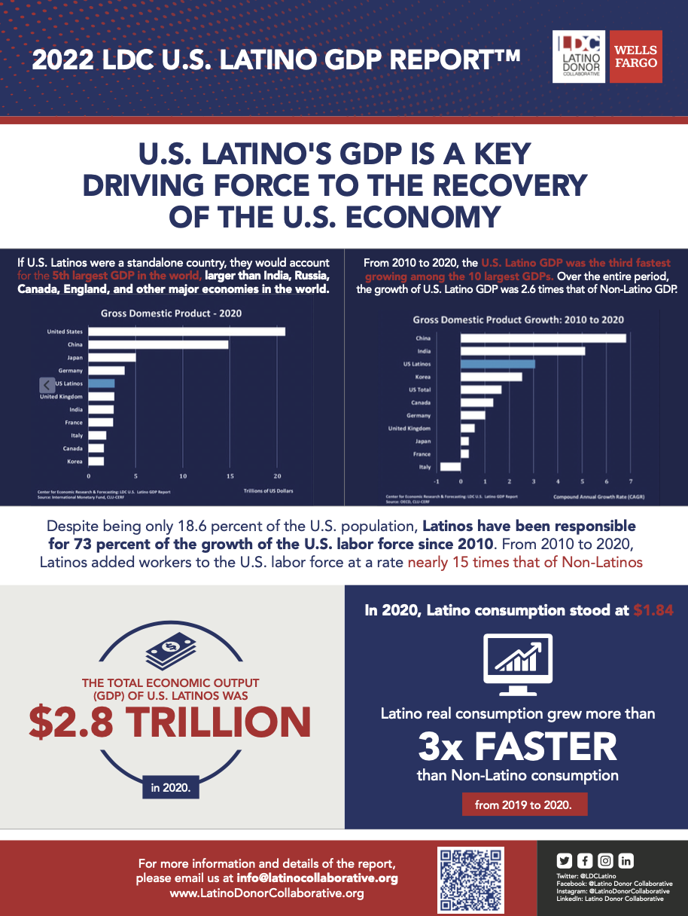
Things You won’t hear on
Fox News
We are either victims or gaming the system
Latinx Drive the US Economy, they aren’t’ a burden
We make jobs , not take them
We have tremendous financial power

Slide 8
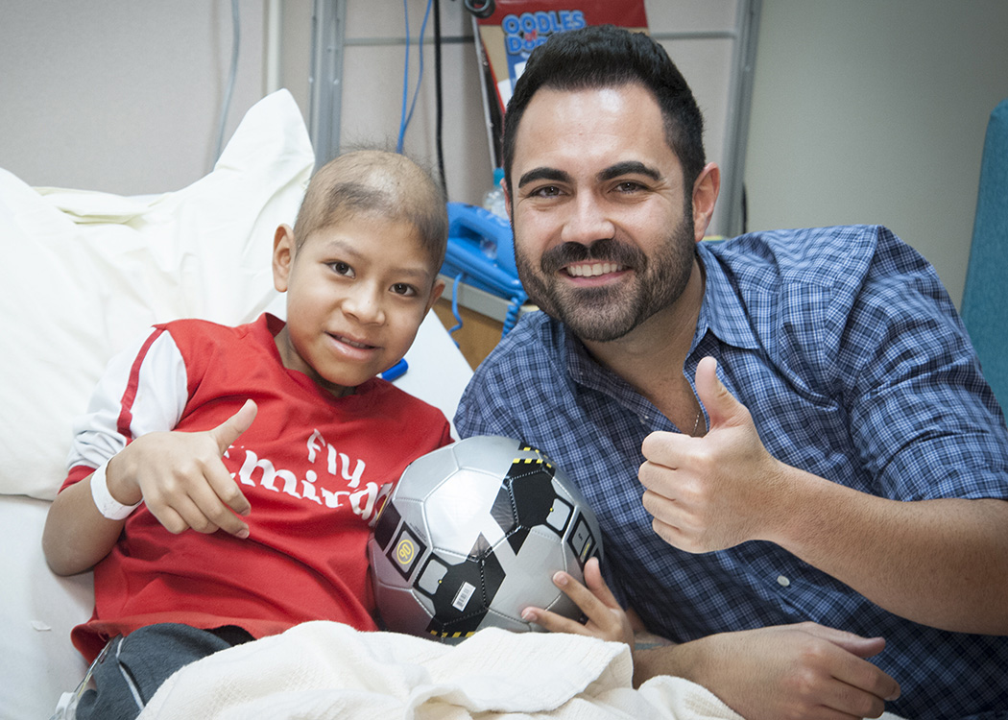
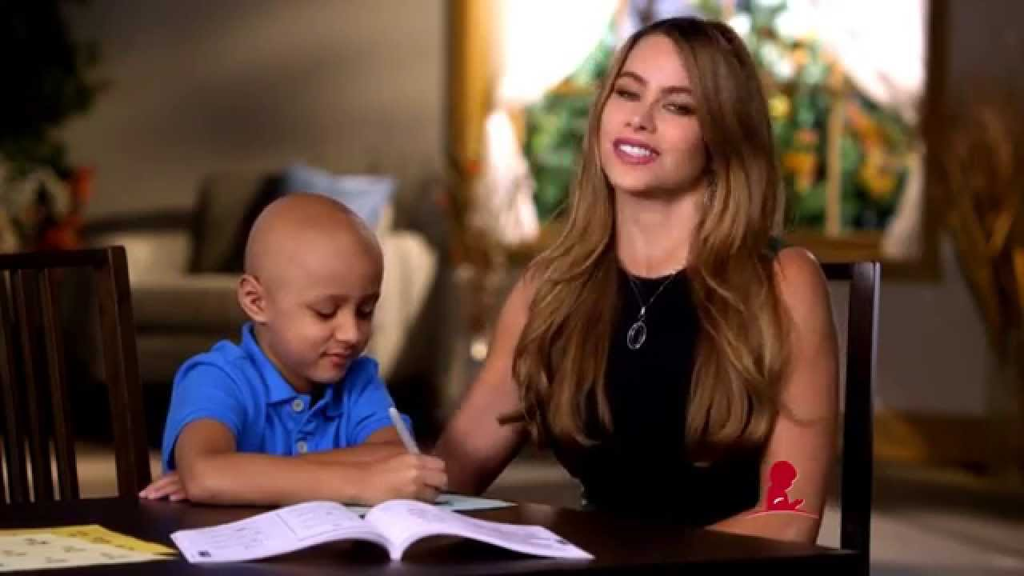
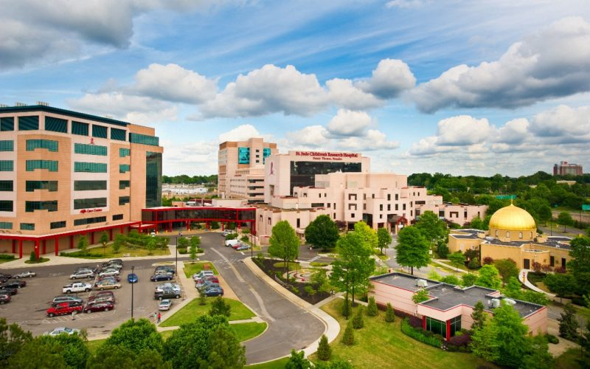
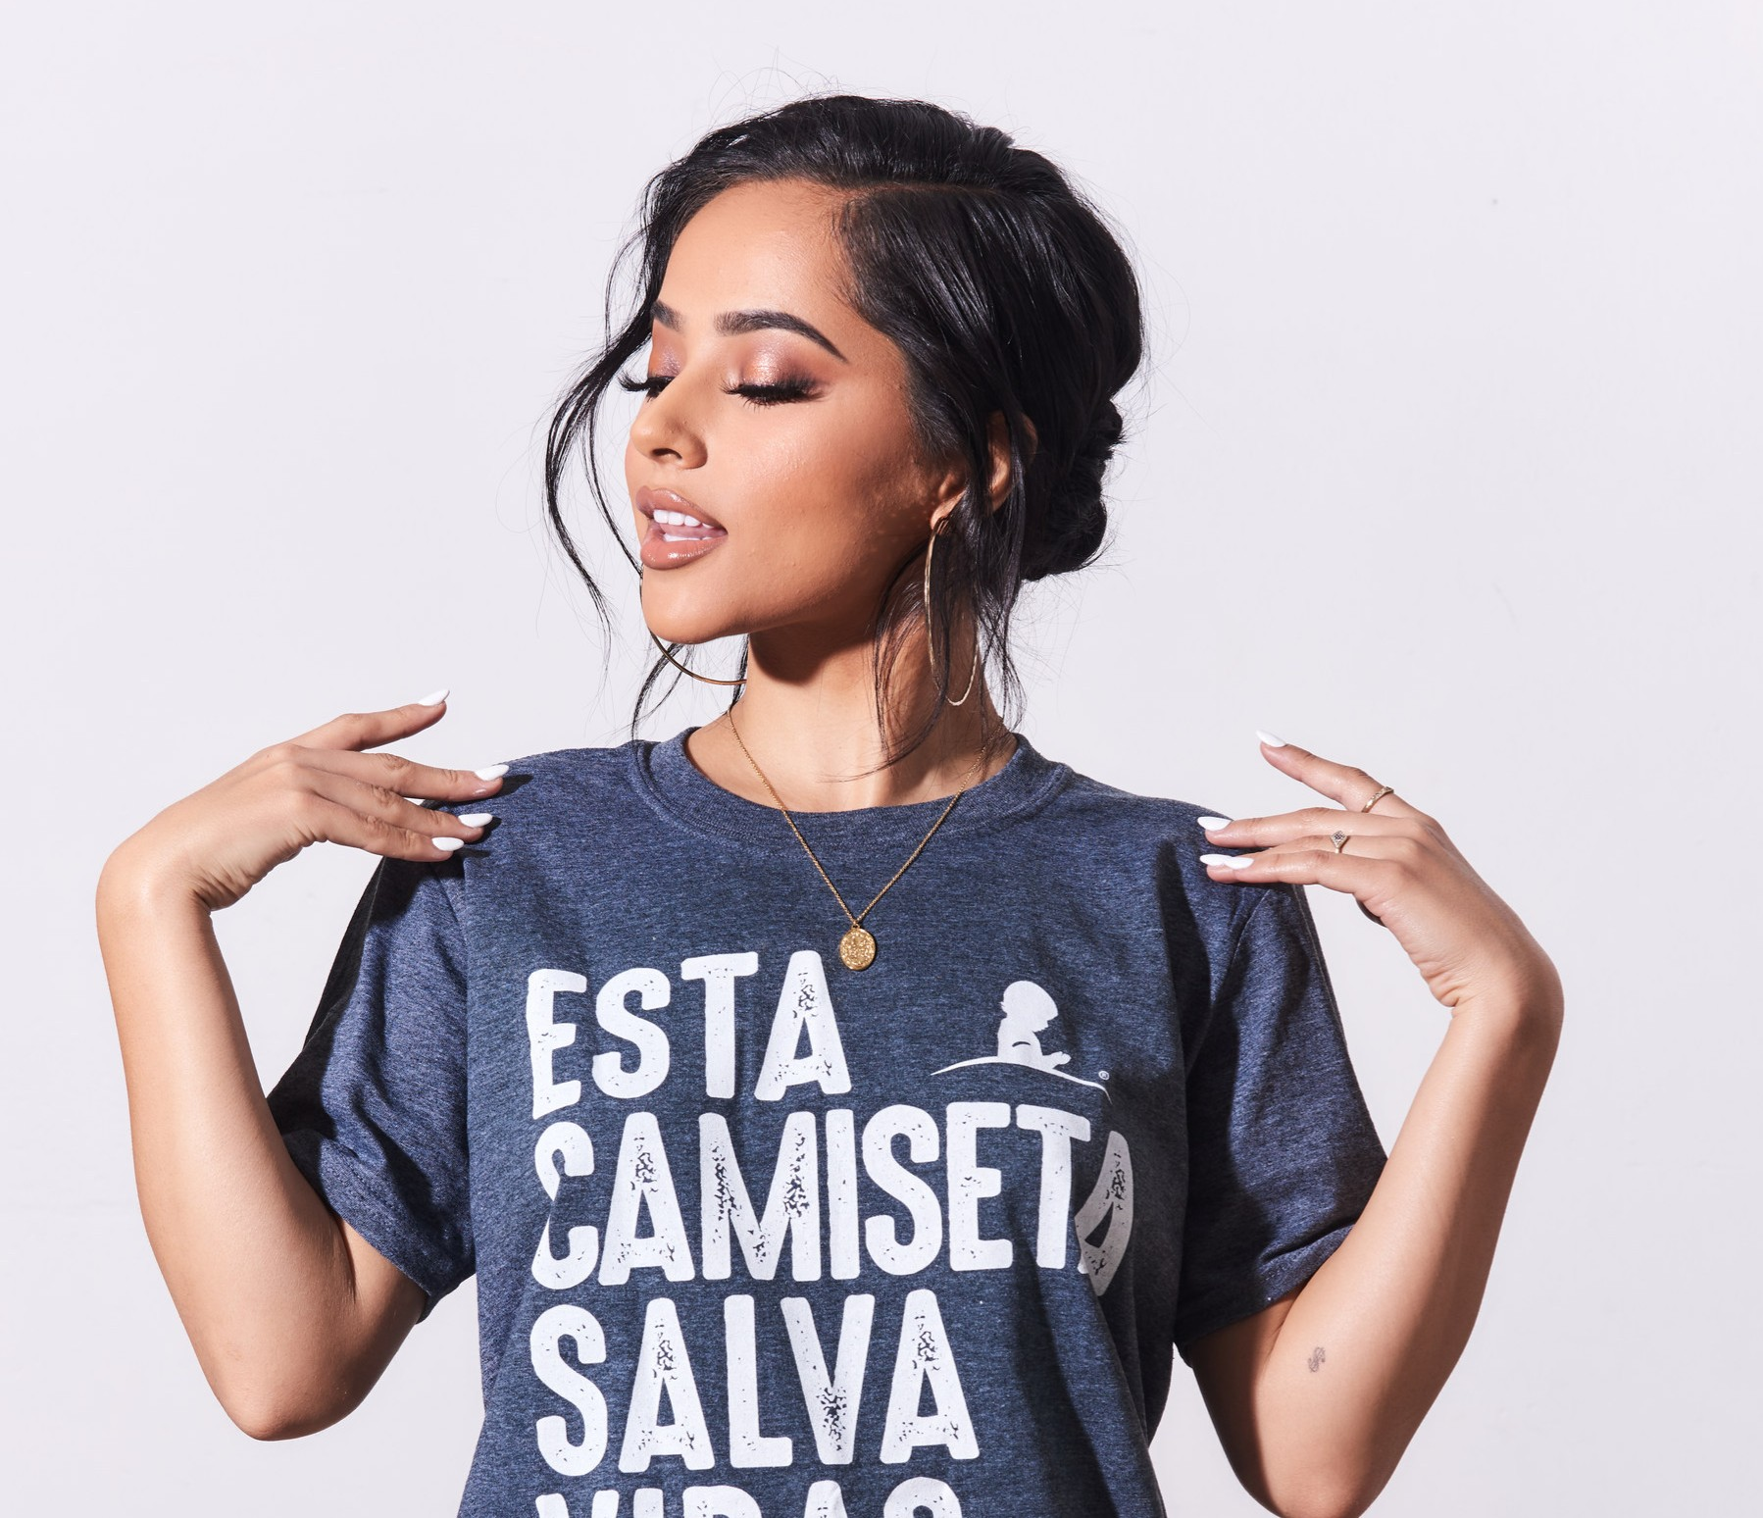
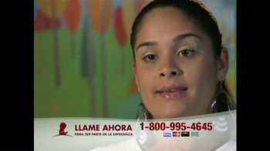
“But they are not philanthropic”
Promesa y Esperanza since 1997 - $150 million
In Store Campaigns
Telethons
Mailings
Univision $3.8-$5.2 million a year

Slide 9
Agenda
Demographics and Data
Why Aren’t Latino’s Giving More?
Where are the Latino development leaders?
Caring about the problem
Generations
What we give to
What motivates us

Slide 10
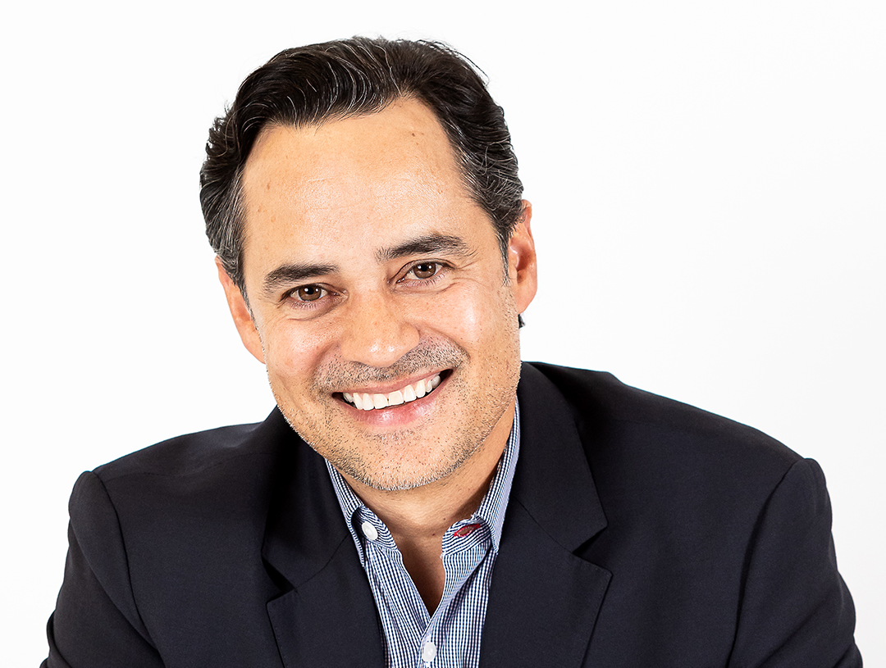
Arts Example
36 years old, married
Tech entrepreneur
Major university grad
Worked at major tech company
Never approached for philanthropy before?!?
Shepard and educate
$1.1 million dollar gift
3 meetings

Slide 11
What about Poverty??
Yes, we have higher poverty rates
But we also have growing wealth
#1 new business being started by Latinas.
Wealthy Mexicans and other Latinos moving here
Growing throughout key industries in the US
Higher philanthropy than you’d expect
Untapped

Slide 12
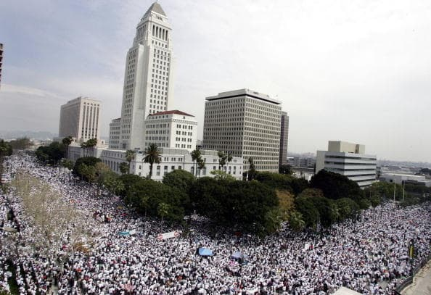
Since 2016
Latinos see a direct threat to their families and safety
Trump won on making hating Mexicans OK
Prime time for Latino Major Giving

Slide 13
Demographics

Slide 14
Latinos Give
Latinos are the second highest racial group in giving, surpassing Asians and African Americans. Of donor 73% White, 11% Latinos, 9% African Americans and 5% Asian American.
Several studies show that race isn’t the number one predictor of major philanthropy. It’s income and being asked.
And there is the Catholic Church

Slide 15
What do we give to?
Church/Religion 45%
Local social service 30%
Children’s Charities 40%
Health Charities 31%
Animal Rescue/Shelters 21%
Emergency Relief 17%
Veterans 20%
Formal Education 15%
Fire, Police Organizations 12%

Slide 16
How do we give?
Added Donation at Check out? 43%
Responded to mail 27%
Giving online/website 23%
Purchase with portion of the proceeds 28%
Gave at an event 27%
Made a gift door to door/street 22%
Gave through 3rd party vendor 23%
Gave through monthly , EFT 17%

Slide 17
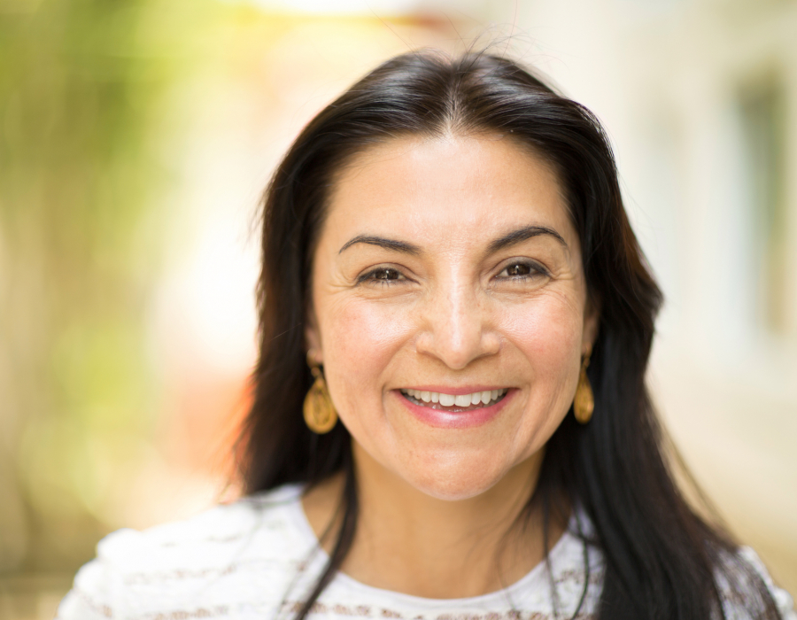
Example 2
Major Law firm partner
Politically active and philanthropic at $5,000 level (FEC)
Never given to a nonprofit more than $500
Making $400k or more
Married no kids
$75,000 gift
2 year pledge, 4 payments

Slide 18
Attitudes about Giving
Organizations that provide direct services, especially one’s we are familiar with.
More likely to give if family/friends tell me about it.
Overhead is a concern.
It’s my personal responsibility if asked.
I actively research a charity before giving.
Spontaneity is important
Heartstrings work

Slide 19
Most Nonprofits
Don’t fundraise effectively in the first place
90% of nonprofits raise under $10 million
Major Giving is avoided and misunderstood
Prospect Research is commonly misused
Latino nonprofits also have no major giving programs

Slide 20
Universities and Major Institutions
There is some progress in engaging Latino donors
Mostly unrecognized as wealth
Unconscious bias
Cultural blind spot, no Latino Major Gifts Officers

Slide 21
First, we have to see the Problem
Do you have Latinos in your community?
But your staff is mostly white, how do you know there is a problem?
Cultural blinders
Do we have any focus on this population? Program to approach them?
The vast majority of Development Teams don’t even think of Latinos as donors, let alone Major Donors.

Slide 22

What does your Board look like?
I will bet you don’t have any Latino's
If you do I would bet they aren’t major donors?
Nationally only 3.5% of Board’s have Latino Board Members.
Do you research, recruit some

Slide 23
What does your staff look like??
Administrative staff
Development Staff
Major Gifts Staff
Why?
  Not a recognized career amongst Latinos
  Racism, yeah racism
  Sexism
Your Staff should look like the community you want to raise money from.

Slide 24
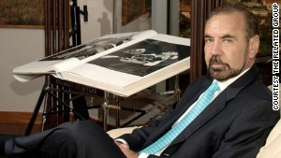
We simply aren’t asked
Top issue
Overlooked unconsciously
Implicit Bias and Racism
Seen as victims
My million-dollar donor
Billionaire Jorge Perez, $40 million donor

Slide 25
English or Spanish?
Depends on the generation
55% percent say they prefer English
Cultural connectivity matters and helps
Plus don’t forget there is many types of spanish

Slide 26
There is no one Latinx
Most are Mexican Americans
But don’t forget Puerto Ricans, Dominicans, Cubans, Salvadorans, Chileans and many other areas.
A Guatemalan woman who has been in the country for 5 years and 2nd generation Mexican/ Chicana American woman lawyer in LA have very different lives
.

Slide 27
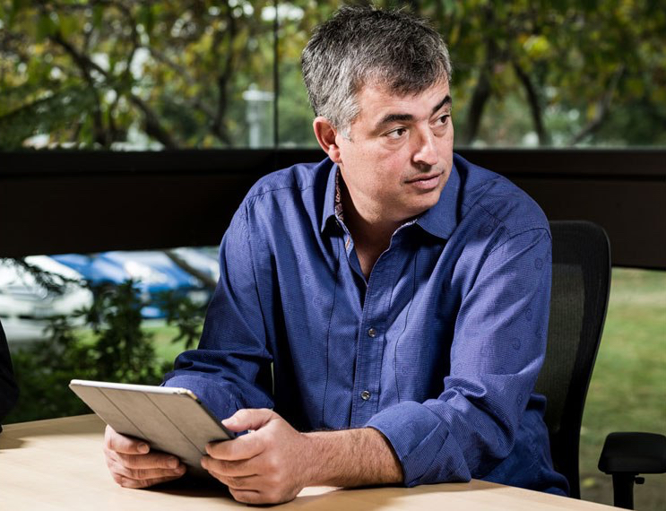
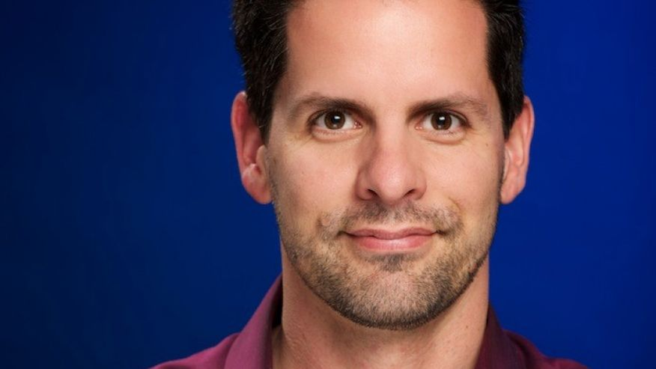
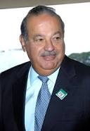
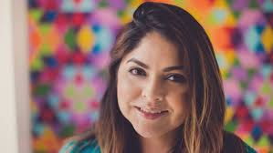
We work in a range of Industries
Construction
Tech
Law
Entertainment
Food and Markets
Parking Lots
Trucking

Slide 28

Prospect Research
Its simple: DO YOUR RESEARCH !
In my last job…..
$ 3.2 million in 9 months, one $1.1 million donor
Studies families
Study transplants
Study circles of influence
Know the issues your working on, are they relevant to this community?

Slide 29
Culture and Age
Older Latino's are more conservative generally
Build Latina giving circles amongst identified wealth
We are more attracted to celebrity appeals
Lock on issues that affect us
Identify leaders in the community

Slide 30
Resources
Please check out these great organizations working on these issues, studies and other articles:
Somos El Poder: www.somoselpoder.org
History of Latino's and Philanthropy http://www.philanthropy.org/programs/literature_reviews/latino_lit_review.pdf
The Pew Center, source of great info: http://www.pewhispanic.org/
Great Article about Marketing: http://www.thenonprofittimes.com/news-articles/marketing-to-hispanics-is-more-than-language/
Chronicle of Philanthropy study: www.philanthropy.org/publications/online_publications/latino_paper.pdf
Famous Philanthropists: https://issuu.com/guerrerohowe/docs/hip_issuu
Great Marketing Book by Isabel Valdes: http://isabelvaldes.com/
Latino Donor Collaborative www.latinodonorcollaborative.org

Slide 31
Conclusion
Recruit Board and Staff that are Latino's, No tokens please
Study Latino wealth and upward mobility in your area
Identify the issues you work on that match our interests
Do your Prospect Research ! ID Leaders.
Get out the door, engage the community, qualify
Look for cultural/age issues
ASK US !

Slide 32
Thanks for Coming!
Consulting and Training
www.armandozumaya.com
For Latinx fundraising professionals and Latinx-serving institutions
www.somoselpoder.org

